Slide 1

SPRINT 2
By Gowtham Raj K R

Slide 2
Agenda
Overview of Development, Testing and Production Environments
Introduction To Development Tools
Introduction to Visual Studio and Visual Studio Code.
Source Control
Sample Program of C#.
Control Flow Statements
C# OOPS

Slide 3
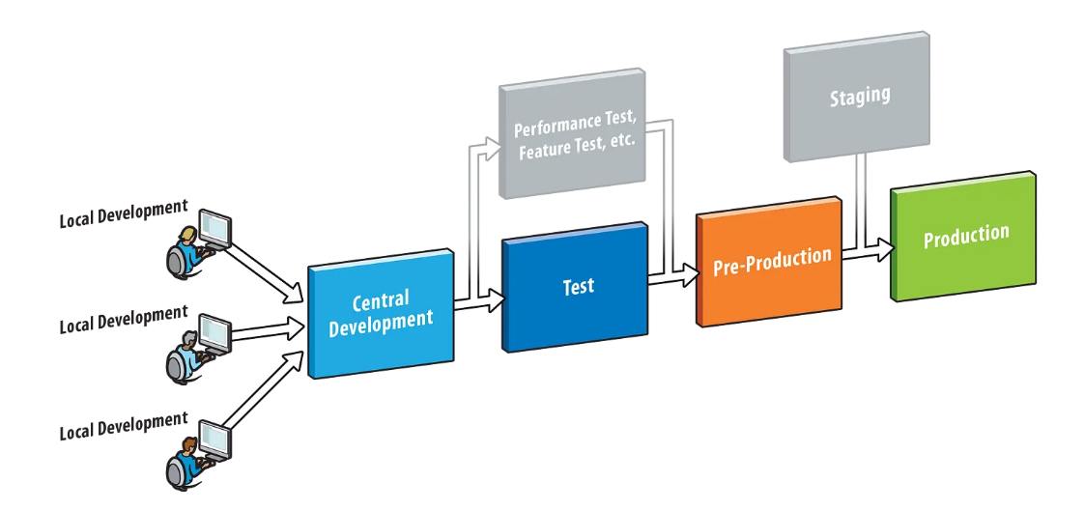
Overview of Development, Testing And Production Environments

Slide 4
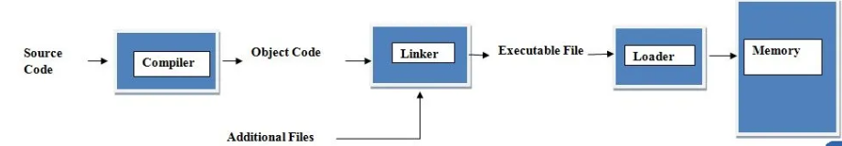
Introduction to Development Tools
IDE (Integrated Development Environment)
Compiler
Linker
Debugger

Slide 5
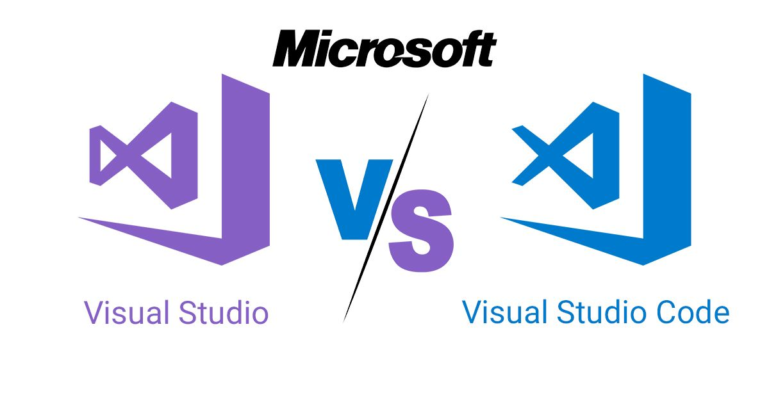
Introduction to Visual Studio and Visual Studio Code

Slide 6
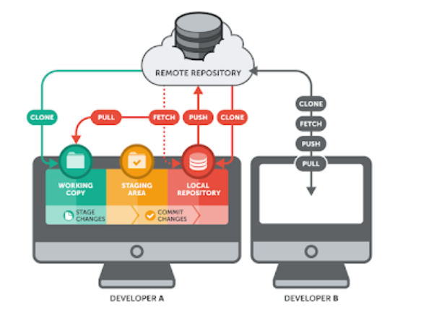
What is Source Control?

Slide 7
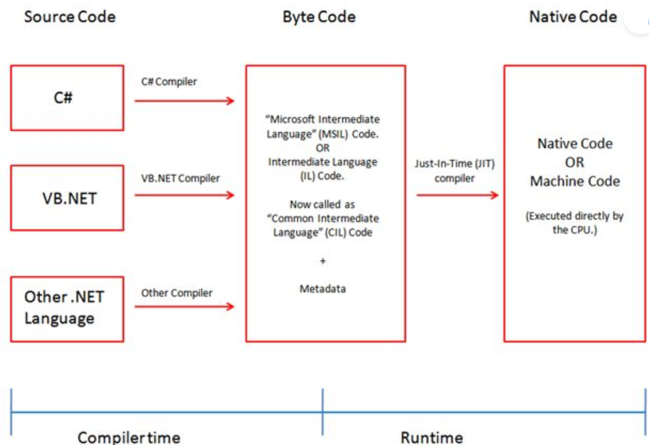
What is C# and its uses?

Slide 8
Sample Program of C#
using System;
namespace demo {
class demo {
static void Main(string[] args) {
string name = Console.ReadLine();
Console.WriteLine(“ The Name Entered By User is : “ +name);
}
}
}
Basic Concepts of C#
Identifiers
Variables
Datatypes
Type Casting
Type Conversion Methods
Operators
Control statements
Array
Methods

Slide 9
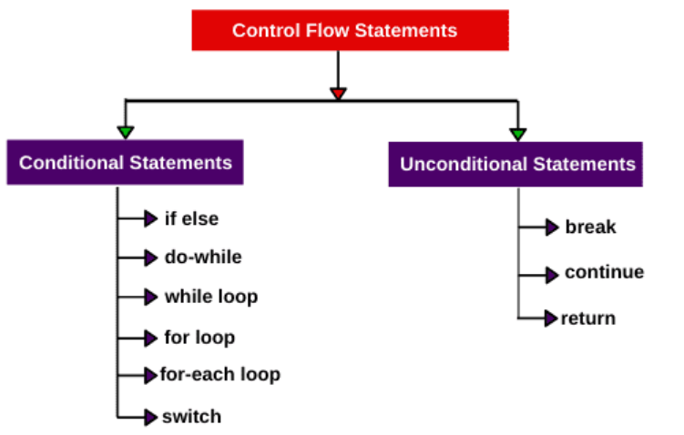
Control flow statements

Slide 10
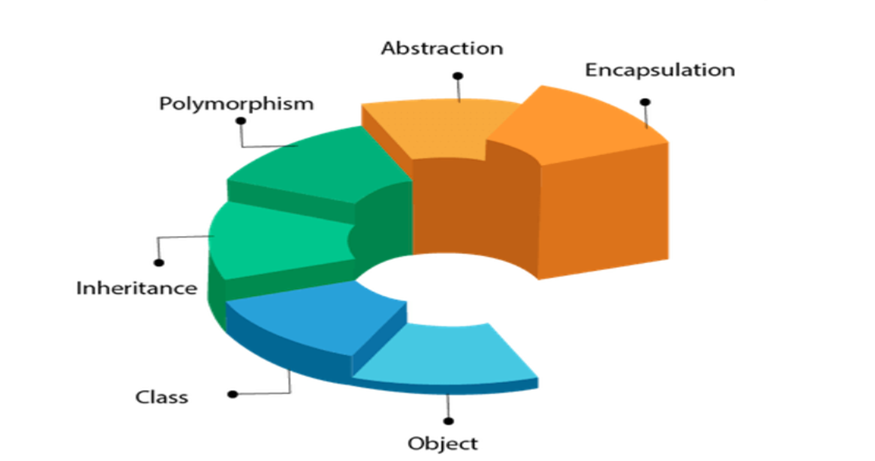
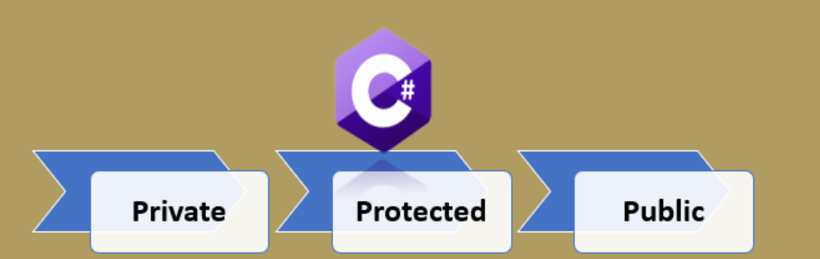
C# OOPS
Object
Class
Inheritance
Polymorphism
Abstraction
Encapsulation

Slide 11




